Slide 1


Slide 2

The Future of Microservice Virtualization: Docker
ATLANTA | AUSTIN | PHILADELPHIA | BENTONVILLE | ROMANIA | INDIA | AUSTRALIA | BRAZIL | NEPAL | CANADA
www.softvision.com

Slide 3
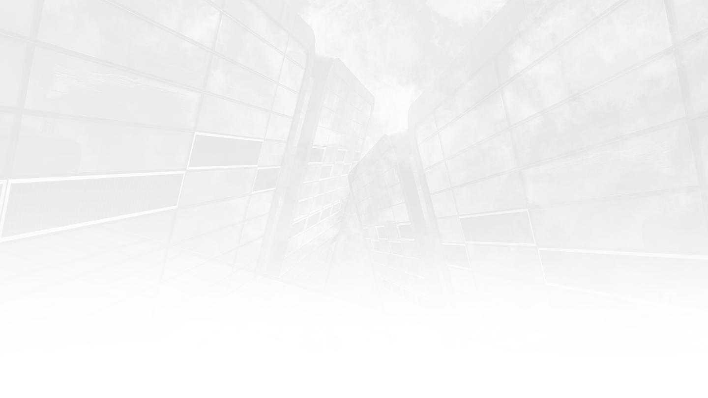


About me
Senior devops engineer for Softvision for the last 3 years
Dedicated systems engineer for 2 years previous
LAMP stack programmer during college
Linux enthusiast
Big believer in automation
ATLANTA | AUSTIN | PHILADELPHIA | BENTONVILLE | ROMANIA | INDIA | AUSTRALIA | BRAZIL | NEPAL | CANADA
www.softvision.com

Slide 4

Presentation goals
Demystify the concept of microservices
Explain what virtual containers are
Present a working example
ATLANTA | AUSTIN | PHILADELPHIA | BENTONVILLE | ROMANIA | INDIA | AUSTRALIA | BRAZIL | NEPAL | CANADA
www.softvision.com

Slide 5
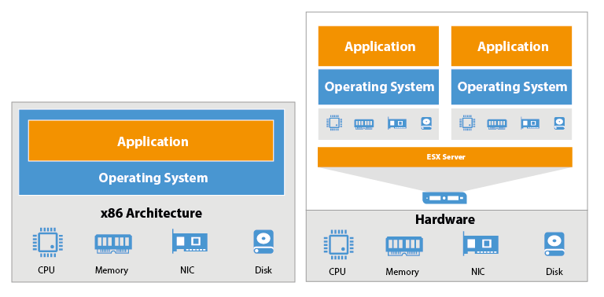
Short Virtualization History
Initially started with physical servers
Later on it evolved to virtualization
This still left room for improvement
ATLANTA | AUSTIN | PHILADELPHIA | BENTONVILLE | ROMANIA | INDIA | AUSTRALIA | BRAZIL | NEPAL | CANADA
www.softvision.com

Slide 6
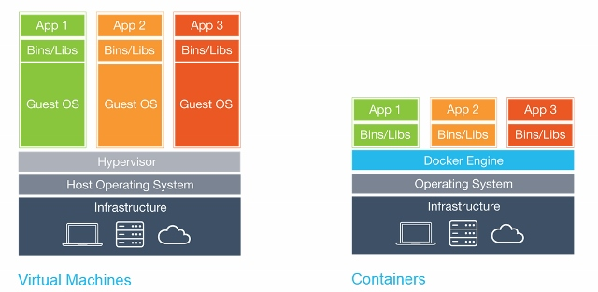
Introducing Virtual Containers
Small footprint
Works anywhere
CI friendly
Perfect for Microservices
ATLANTA | AUSTIN | PHILADELPHIA | BENTONVILLE | ROMANIA | INDIA | AUSTRALIA | BRAZIL | NEPAL | CANADA
www.softvision.com

Slide 7
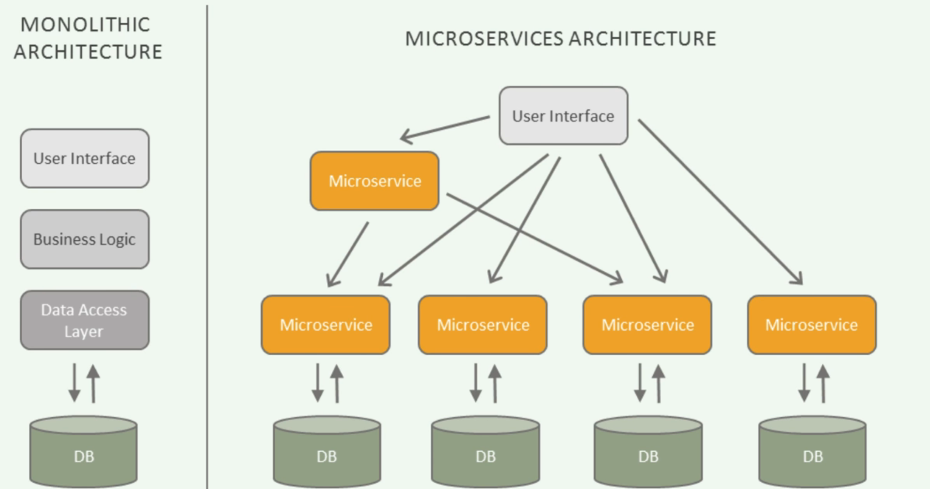
What Defines a Microservice Architecture?
Modular application design
Each functionality is designed as a standalone service
These services communicate between themselves via APIs
ATLANTA | AUSTIN | PHILADELPHIA | BENTONVILLE | ROMANIA | INDIA | AUSTRALIA | BRAZIL | NEPAL | CANADA
www.softvision.com

Slide 8
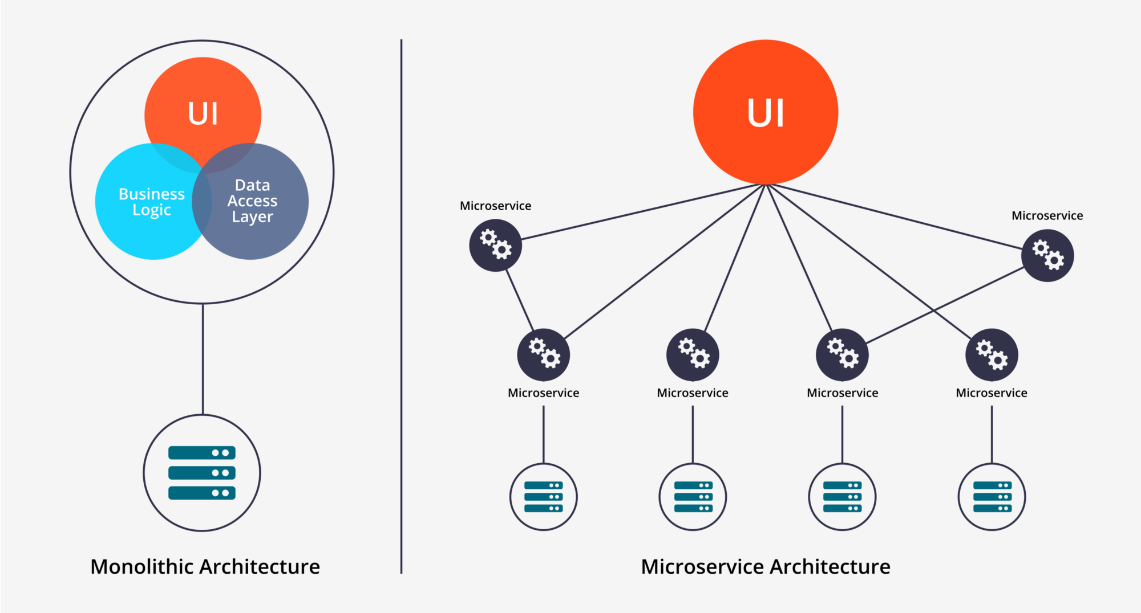
Why Microservices?
Language independent
Fast iterations
Small teams
Fault isolation
Scalable
ATLANTA | AUSTIN | PHILADELPHIA | BENTONVILLE | ROMANIA | INDIA | AUSTRALIA | BRAZIL | NEPAL | CANADA
www.softvision.com

Slide 9
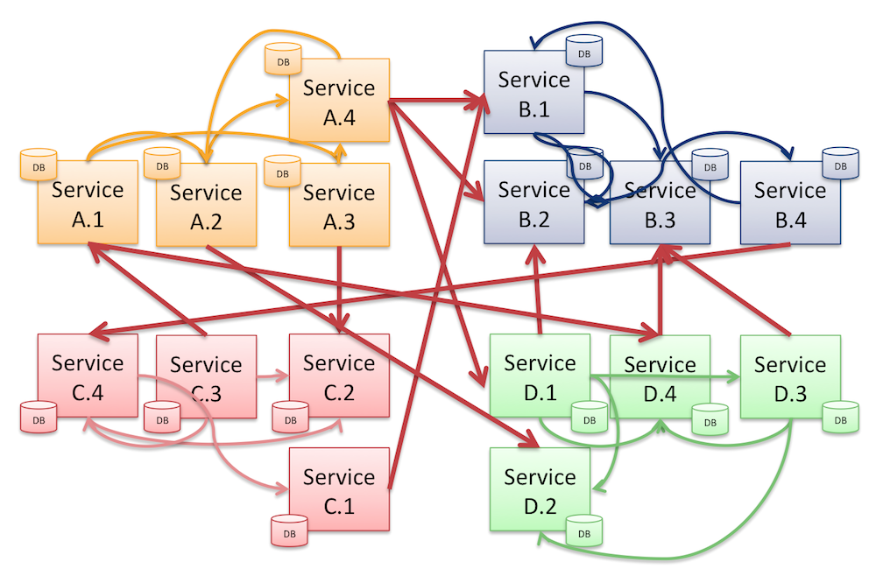
Disadvantages
Can become overly complex
It requires teams to be in sync more than what is usually the case
Can create overhead
Debugging can be harder
ATLANTA | AUSTIN | PHILADELPHIA | BENTONVILLE | ROMANIA | INDIA | AUSTRALIA | BRAZIL | NEPAL | CANADA
www.softvision.com

Slide 10
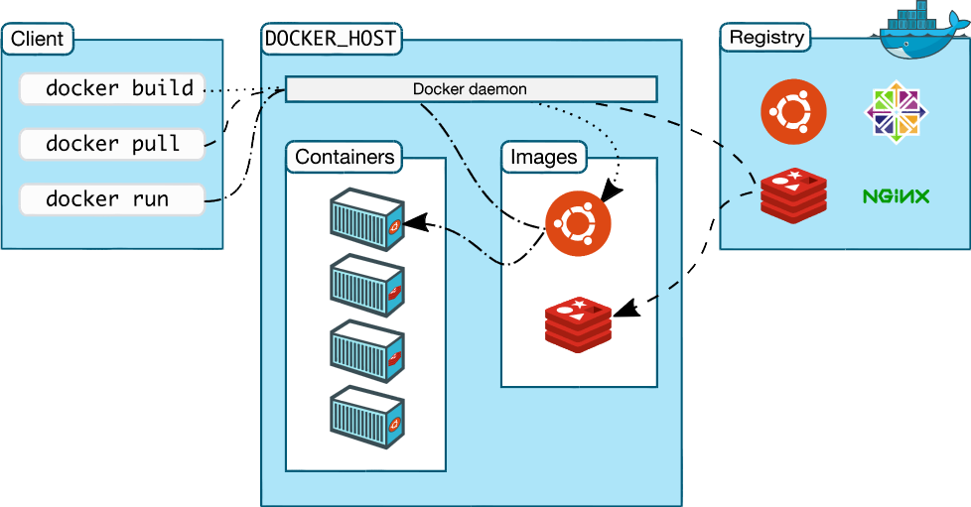
Understanding Docker Architecture
ATLANTA | AUSTIN | PHILADELPHIA | BENTONVILLE | ROMANIA | INDIA | AUSTRALIA | BRAZIL | NEPAL | CANADA
www.softvision.com

Slide 11
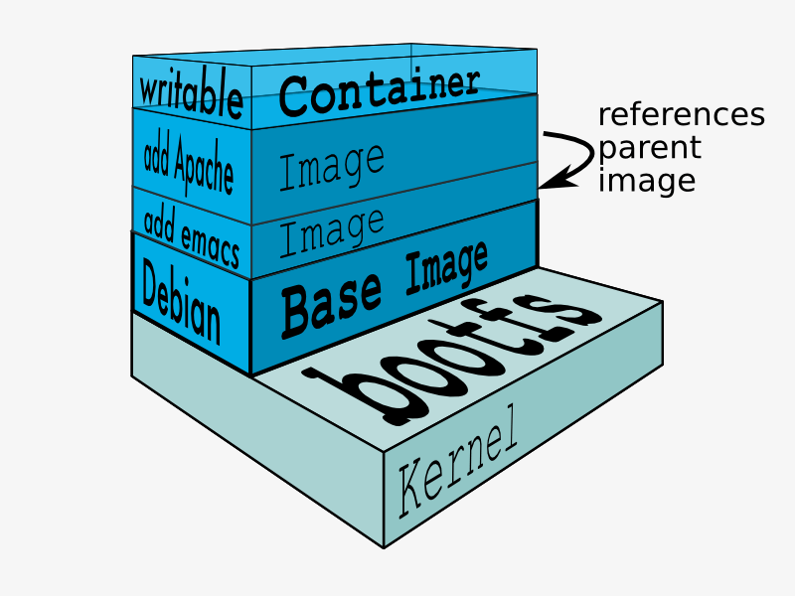
What Is A Docker Image
Most similar analogy is to a VM virtual hard disk
Has a couple of advantages
Is layered
Allows for commits and reverts
Can be shared both as a finished block of data or as a text file of build instructions known as a Dockerfile
ATLANTA | AUSTIN | PHILADELPHIA | BENTONVILLE | ROMANIA | INDIA | AUSTRALIA | BRAZIL | NEPAL | CANADA
www.softvision.com

Slide 12
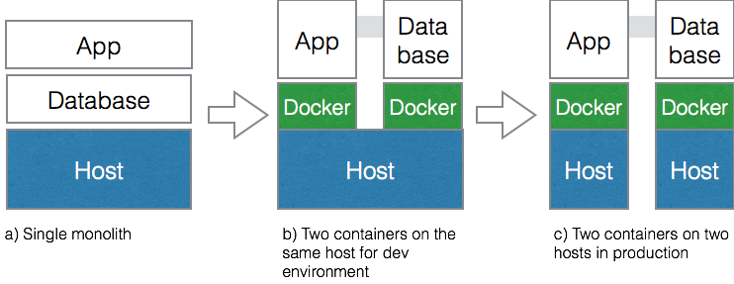
How Do I Microservice?
Let's setup a simple php webserver with a mysql backend using microservices.
ATLANTA | AUSTIN | PHILADELPHIA | BENTONVILLE | ROMANIA | INDIA | AUSTRALIA | BRAZIL | NEPAL | CANADA
www.softvision.com

Slide 13
Conclusions and where to go next
Virtual containers are shaping up to be very promising
Most big cloud providers are now providing native Docker support
The technology is maturing very fast following wide-spread adoption
Docker orchestrators: Kubernetes
ATLANTA | AUSTIN | PHILADELPHIA | BENTONVILLE | ROMANIA | INDIA | AUSTRALIA | BRAZIL | NEPAL | CANADA
www.softvision.com

Slide 14


